Slide 1

Web Service and Database Handling part 2 - Parameters and Nested JSON
Emerging Technology : Flutter
Week 9
Program Studi Teknik Informatika
Fakultas Teknik – Universitas Surabaya

Slide 2

PARAMETERIZED WEB SERVICE
01

Slide 3

Parameterized Web Service
It is very common for web service to take requests equipped with parameters as input for filtering the response from database server and also as data for inserting something to database, etc.. .
For simple example, we will add a parameter in a web service we already prepared in previous week for filtering the title of the movie. Movies listed on the web service are movies which title contain word in the parameter.

Slide 4
Update web service
Add in our previous web service a WHERE sentence to filter the movie title.
$cari="%".$_POST['cari']."%";
$sql = "SELECT * FROM movie where title like ? ";
$stmt = $conn->prepare($sql);
$stmt->bind_param("s",$cari);
$stmt->execute();
make sure it run well. try it first with postman

Slide 5
Add textbox
Add a textbox for inputting filter text. When user press enter, it will request data to webservice.
TextFormField(
decoration: const InputDecoration(
icon: Icon(Icons.search),
labelText: 'Judul mengandung kata:',
),
onFieldSubmitted: (value) {
setState(() {
_txtCari = value;
});
PMs.clear();
bacaData();
},
),
Prepare local variable
String _txtcari='';
Update initState
@override
void initState() {
super.initState();
bacaData();
_txtCari = "";
}

Slide 6
Update bacadata
bacaData() {
Future<String> data = fetchData();
data.then((value) {
Map json = jsonDecode(value);
if(json['result']=='success')
{
for (var mov in json['data']) {
PopMovie pm = PopMovie.fromJson(mov);
PMs.add(pm);
}
}
else
{
PMs.clear();
}
setState(() {
});
});
}
Update bacadata so it can handle if the API return no data because of the filter

Slide 7
Update fetchdata and interface
In fetchdata change http.get to http.post, and add the parameter.
Future<String> fetchData() async {
final response = await http.post(Uri.parse("https://ubaya.cloud/flutter/[NRP]/movielist.php"),body: {'cari': _txtcari}
);
If there is no data, we will show an information text.
Container(
height: MediaQuery.of(context).size.height - 200,
child: PMs.isNotEmpty ? DaftarPopMovie(PMs)
: const Text("tidak ada data"),
)

Slide 8
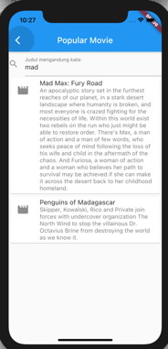
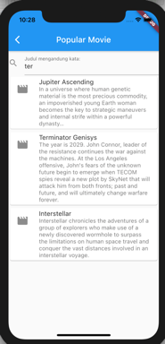
Check the result
Run and do several filtering with different keyword

Slide 9
LOGIN HANDLING
02

Slide 10
Database Preparation
For the second example, we will fix our login screen which we built in previous weeks when we study about shared preferences.
We will use master_user table which already in our database.

Slide 11
Prepare the web service
Create a web service to handle login. For example login.php
//write after connection initiation
extract($_POST);
$sql = "SELECT * FROM master_user where user_id=? and user_password=?";
$stmt = $conn->prepare($sql);
$stmt->bind_param("ss",$user_id,$user_password);
$stmt->execute();
$result = $stmt->get_result();
if ($result->num_rows > 0) {
$r=mysqli_fetch_assoc($result);
$arr=["result"=>"success","user_name"=>$r['user_name']];
} else {
$arr= ["result"=>"error","message"=>"sql error: $sql"];
}
echo json_encode($arr);

Slide 12
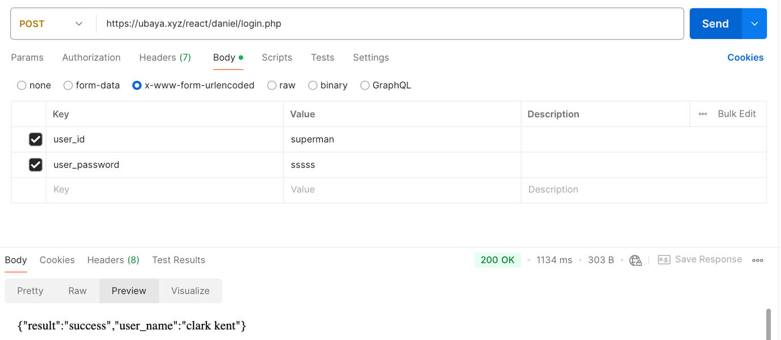
Check web service

Slide 13
Update onclick login
Tambah variabel pesan error
String _error_login = "";
Set nilainya di initState
@override
void initState() {
super.initState();
_emailController.text = "";
_passwordController.text = "";
_error_login = "";
}
Buat widget text error
Padding(
padding: const EdgeInsets.all(10),
child: Text(
_error_login,
style: const TextStyle(color: Colors.red),
)),

Slide 14
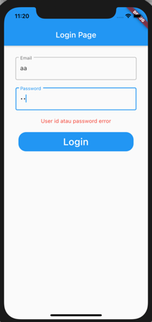
Update onclick login
void doLogin() async {
final response = await http.post(
Uri.parse("https://ubaya.cloud/flutter/[NRP]/login.php"),
body: {'user_id': _user_id, 'user_password': _user_password});
if (response.statusCode == 200) {
Map json = jsonDecode(response.body);
if (json['result'] == 'success') {
final prefs = await SharedPreferences.getInstance();
prefs.setString("user_id", _user_id);
prefs.setString("user_name", json['user_name']);
main();
} else {
setState(() {
_error_login = "Incorrect user or password";
});
}
} else {
throw Exception('Failed to read API');
}
}

Slide 15
MOVIE DETAIL
03

Slide 16
Movie Detail
Next example for parameterized webservice: picking all fields of one record in movie table selected by certain id_movie.
Furthermore, it will also be added with some data as a result of parent-child relation of this table

Slide 17
Web Service detailmovie.php
....
$id=$_POST['id'];
$sql = "SELECT * FROM movie where movie_id = ? ";
$stmt = $conn->prepare($sql);
$stmt->bind_param("i",$id);
$stmt->execute();
$result = $stmt->get_result();
if ($result->num_rows > 0) {
$r=mysqli_fetch_assoc($result);
//nanti ditaruh movie genre dsb..
$arr=["result"=>"success","data"=>$r];
} else {
$arr= ["result"=>"error","message"=>"sql error: $sql"];
}
echo json_encode($arr);

Slide 18
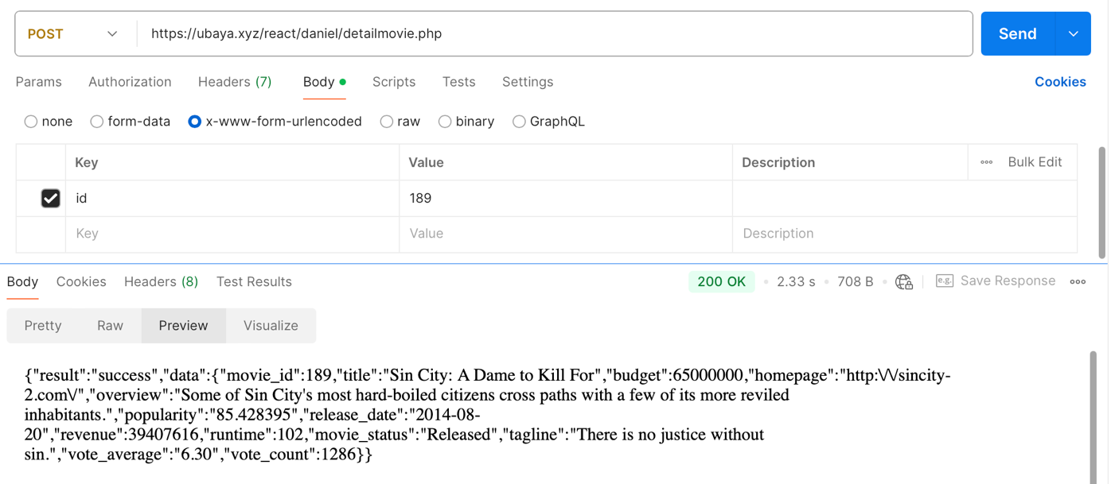
Check Web Service

Slide 19
Page detailpop.dart
Create a new page with stateful skeleton, for showing a movie information. Prepare this page to receive a parameter : movieID
  class DetailPop extends StatefulWidget {
  int movieID;
  DetailPop({super.key, required this.movieID});
  @override
  State<StatefulWidget> createState() {
  return _DetailPopState();
  }
  }
  class _DetailPopState extends State<DetailPop> {
  @override
  Widget build(BuildContext context) {
  return Scaffold(
  appBar: AppBar(
  title: const Text('Detail of Popular Movie'),
  ),
  body: ListView(children: <Widget>[Text(widget.movieID.toString())]));
  }
  }

Slide 20
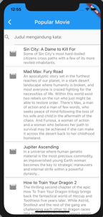
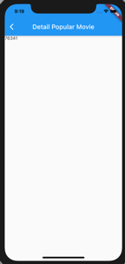
Calling DetailPop
Page DetailPop will open when user click on the movie title in popularmovie page. We can use GestureDetector and its onTap so when the title is tapped, we go to the DetailPop screen (if you want to tap the whole list tile, simply use onTap)
leading: Icon(Icons.movie, size: 30),
title: GestureDetector(
child: Text(PMs[index].title),
onTap: () {
Navigator.push(
context,
MaterialPageRoute(
builder: (context) =>
DetailPop(movieID: PMs[index].id),
),
);
}),
subtitle: Text(PMs[index].overview),

Slide 21
Fix DetailPop
Prepare a variable for storing one movie data using our existing PopMovie class
class _DetailPopState extends State<DetailPop> {
PopMovie? _pm;
@override
void initState() {
super.initState();
bacaData();
}

Slide 22
Fix Page DetailPop (2)
Prepare fetchData and bacaData function.
Future<String> fetchData() async {
final response = await http.post(
Uri.parse("https://ubaya.cloud/flutter/[NRP]/detailmovie.php"),
body: {'id': widget.movieID.toString()});
if (response.statusCode == 200) {
return response.body;
} else {
throw Exception('Failed to read API');
}
}

Slide 23
Fix Page DetailPop (3)
bacaData() {
fetchData().then((value) {
Map json = jsonDecode(value);
_pm = PopMovie.fromJson(json['data']);
setState(() {});
});
}
Pay attention the different of bacaData function here with bacaData in PopularMovie, and its incoming JSON structure.

Slide 24
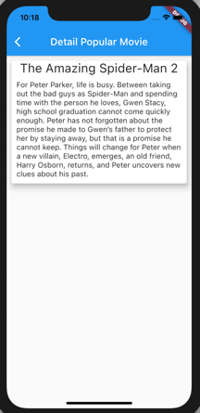
Fix Page DetailPop (4)
Widget tampilData() {
if (_pm == null) {
return const CircularProgressIndicator();
}
return Card(
elevation: 10,
margin: const EdgeInsets.all(10),
child: Column(children: <Widget>[
Text(_pm!.title, style: const TextStyle(fontSize: 25)),
Padding(
padding: const EdgeInsets.all(10),
child: Text(_pm!.overview, style: const TextStyle(fontSize: 15))),
]));
}

Slide 25
NESTED JSON
04

Slide 26
Why nested JSON
In our previous web services, we already get a simple JSON array and JSON object. The JSON structure could come in more complex with a nested structure .
This nested structure often use to carry children's data of the current data. Children data come from one-to-many or many-to-many relation between current main table and other tables.
For example, a JSON of sales order data which also includes its detail order items.
An example that using this nested structure can be used to shows genre of current movie.
A movie can have more than one genre, and a genre can be used by more than one movie. The movie table have many-to-many relation with genre by using movie_genres as a bridging table.

Slide 27
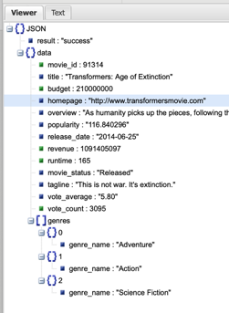
Web Service preparation
We will still use detailmovie.php from our previous example, we add a new JSON object which value is a JSON array.
Put this code at the commented section of detailmovie.php
$sql2 = "SELECT genre_name FROM genre inner join movie_genres
on genre.genre_id=movie_genres.genre_id
where movie_id=$id ";
$stmt2 = $conn->prepare($sql2);
$stmt2->execute();
$genres=[];
$result2 = $stmt2->get_result();
if ($result2->num_rows > 0) {
while($r2=mysqli_fetch_assoc($result2))
{
array_push($genres,$r2);
}
}
$r["genres"]=$genres;

Slide 28
Update Class PopMovie
class PopMovie {
int id;
String title;
String overview;
String vote_average;
List? genres;
PopMovie(
{this.id, this.title, this.overview, this.vote_average, this.genres});
factory PopMovie.fromJson(Map<String, dynamic> json) {
return PopMovie(
id: json['movie_id'],
title: json['title'],
overview: json['overview'],
vote_average: json['vote_average'],
genres: json['genres']
);
}
}
Why nullable list? It’s a bit tricky
Recall on the popular movie screen we use this class, but the API (listmovies.php) do not include the movie genres
If genres is not nullable, we will get a runtime error when opening the popular movie screen, since the JSON does not contain the ‘genres’ array

Slide 29
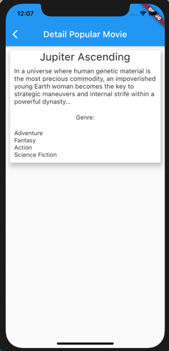
Update tampilData
Add the genre below overview.
const Padding(padding: EdgeInsets.all(10), child: Text("Genre:")),
Padding(
padding: const EdgeInsets.all(10),
child: ListView.builder(
shrinkWrap: true,
itemCount: _pm?.genres?.length,
itemBuilder: (BuildContext ctxt, int index) {
return Text(_pm?.genres?[index]['genre_name']);
}))

Slide 30
EXERCISE
05

Slide 31
Exercise
With the same steps in previous chapter, add information about actor/actress in the movie, equipped with their cast. (taken from person and movie_cast table)
Example:
Robert Downey Jr – Tony Stark/ Ironman
Chris Evan – Captain America

Slide 32



